Slide 1
Computer Networks:
The Physical Layer
Concluding Lecture (08/08)

Slide 2
ABET Course Outcomes for
CS M117
a. Understand the properties of communication channels.
b. Understand signal modulation, multiplexing and multiple access processes.
c. Understand MAC Protocols for reliable and noisy channels.
d. Understand Wireless LAN and Bluetooth design and operations.
e. Final comprehensive project requiring the student to re-design and re-think one of the experiments he/she performed.

Slide 3
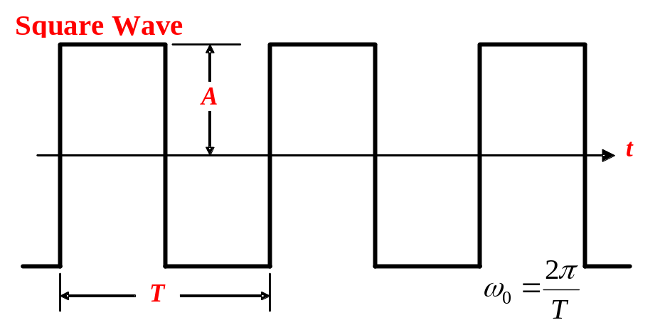
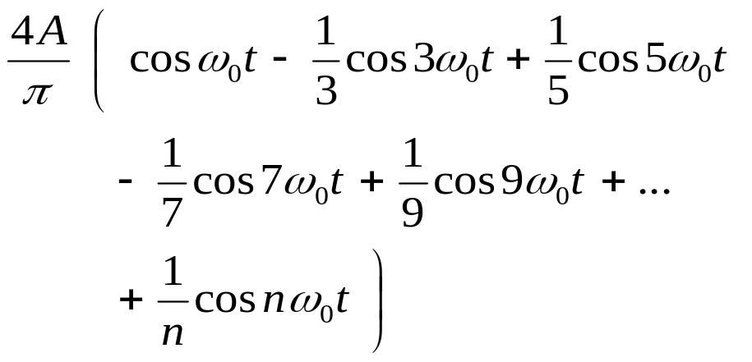
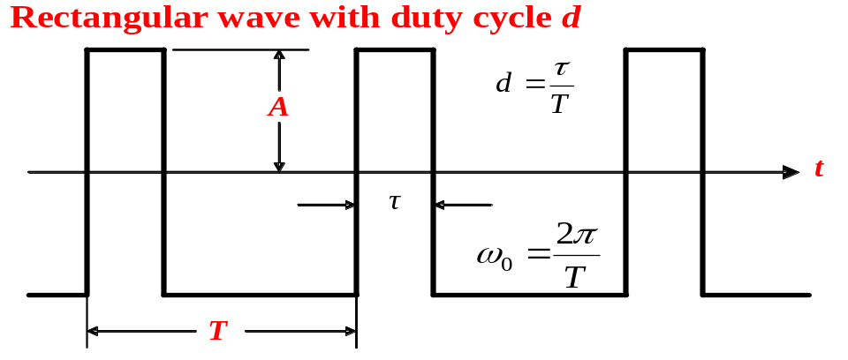
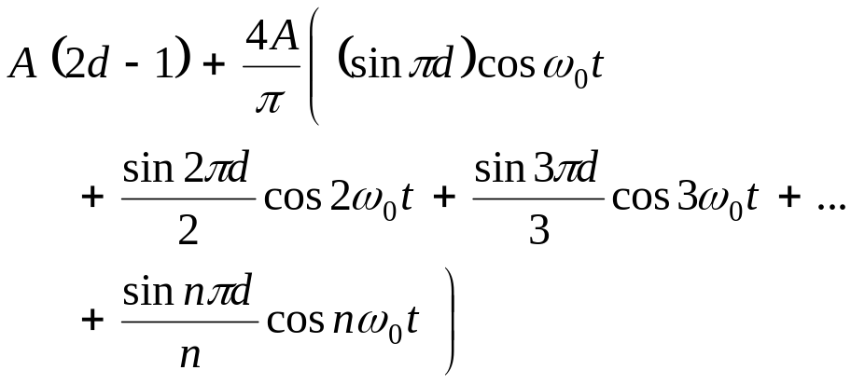

Slide 4
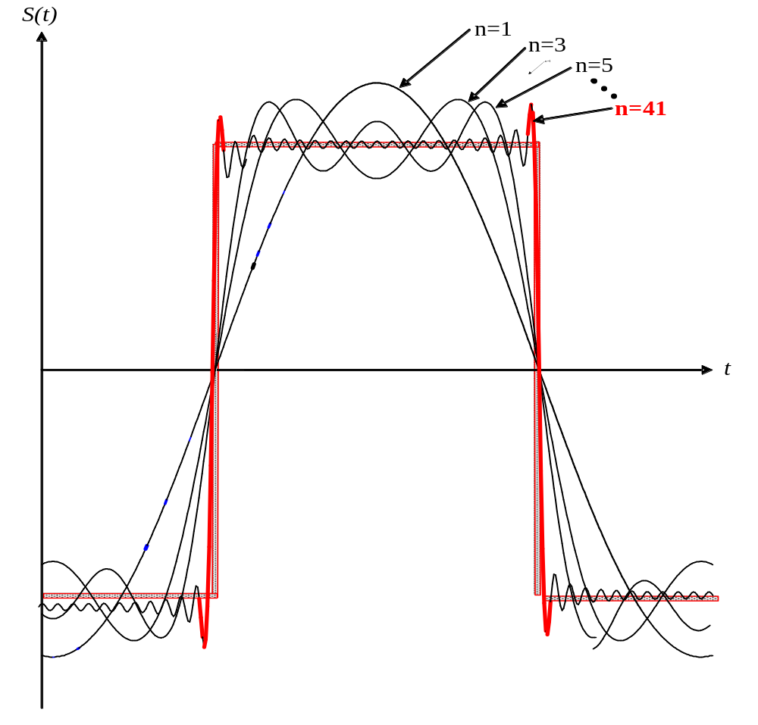
A periodic signal can be decomposed into a set of sine waves

Slide 5
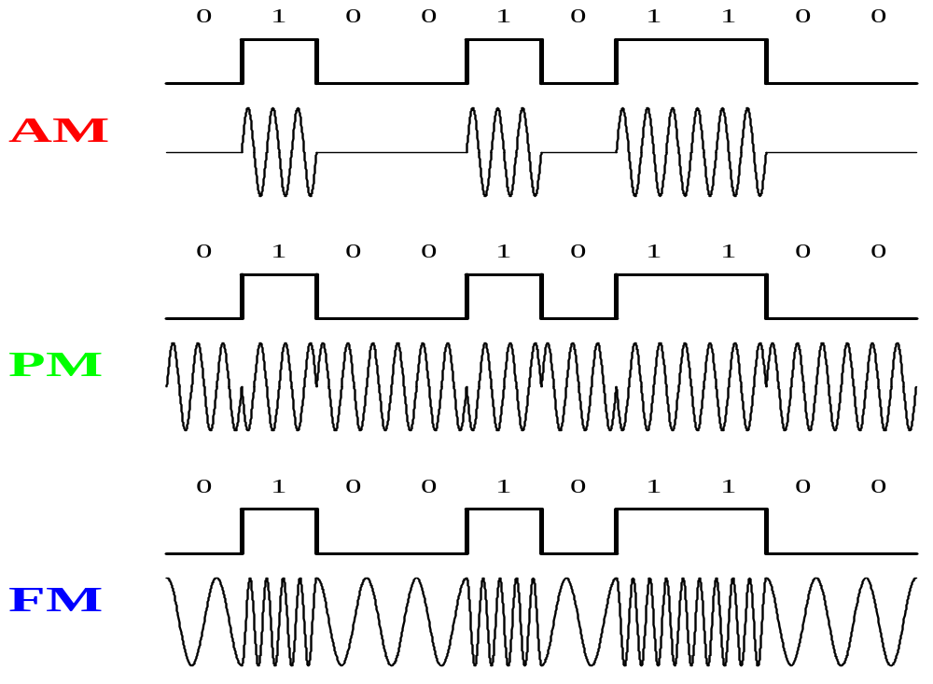
Amplitude, Phase, and Frequency Modulation of a digital baseband signal
ASK, PSK FSK

Slide 6
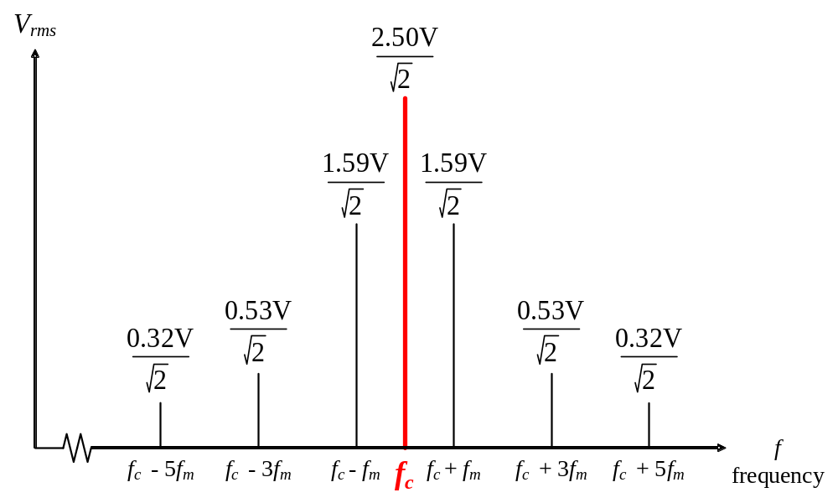
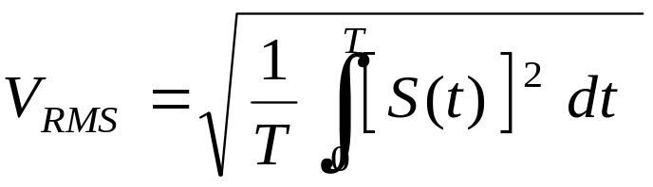
From a time-domain graphs can be determined power,
Frequency, phase and bandwidth of a periodical signal
From a frequency-domain graphs can be determined power
Frequency, phase and bandwidth of a periodical signal

Slide 7
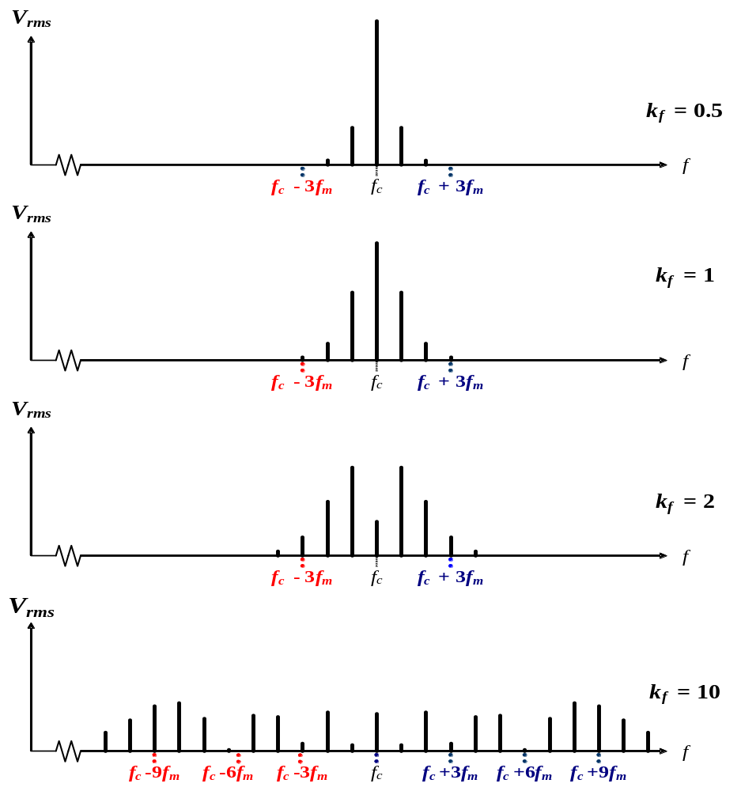
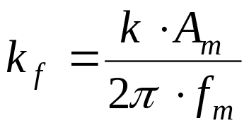
Ac · cos ( 2π fc + k_{f} cos ( 2π fm ) ) at various values of k_{f} .
FDM multiplexing technique shifts each data signal to a different carrier frequency

Slide 8
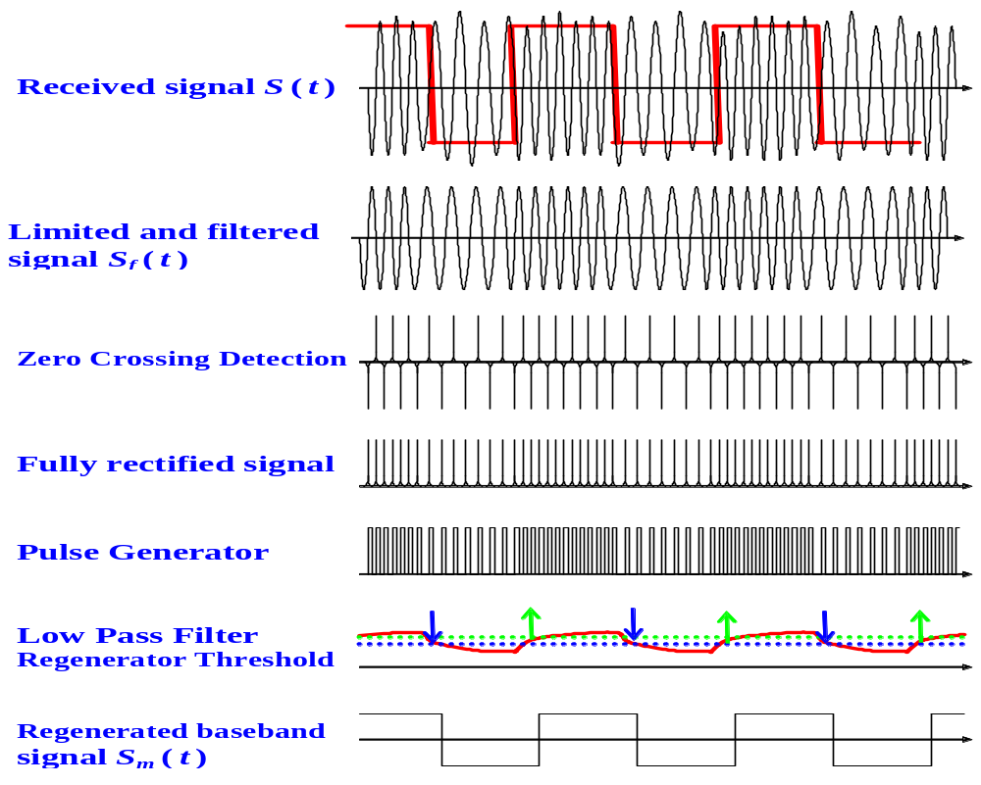
A. Phase-Locked Loop (PLL) B. Zero-Crossing Detection

Slide 9
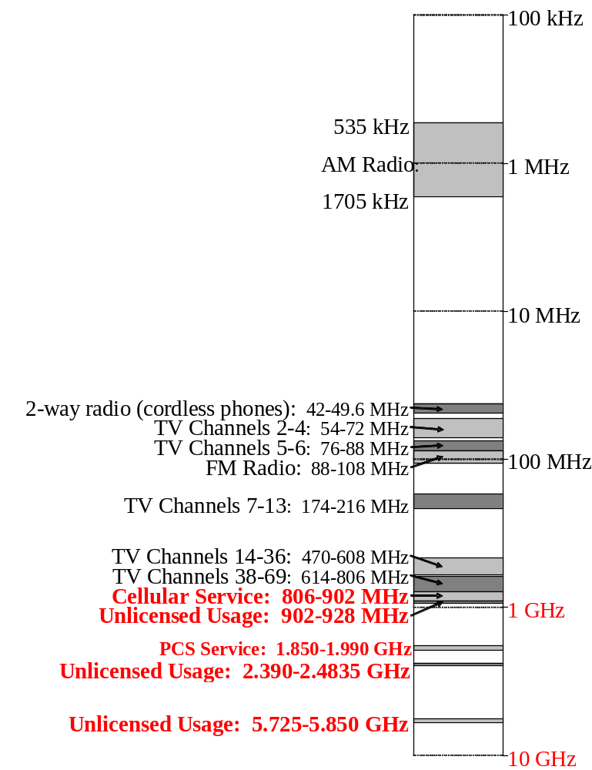
Radio frequencies in the 100 kHz to 10 GHz range.
microwave

Slide 10
Wireless Services
.
Cordless
Bluetooth
ZigBee
WiFi
Cellular
CDMA
P-to-P
802-16
0.7
1.9
1.7
0.4
1
2
3
4
5
6
GHz
0.80-
0.90
0.90-
0.93
1.85-
1.99
2.39-
2.483
5.72-
5.85
10-66 GHz
0.85-1.90
2.15-2.20

Slide 11
Microwave radio systems:
1. Microwave voice/data transmissions
Data-modulate the carrier wave using:
PM, FM, and SS modulation techniques.
2a. Links (channels) are separated with: FDMA.

Slide 12
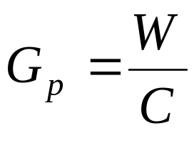
The most important parameter in any SS system is
the processing gain Gp:
This value measures the ratio of
Transmitted RF bandwidth W
to the narrowband information rate C.
A system with a low signal-to-noise ratio must have a high
processing gain Gp in order to recover the original signal.
Types of Spread Spectrum Modulation:
Direct Sequence Spread Spectrum (DSSS)
Frequency Hopping Spread Spectrum (FHSS)

Slide 13
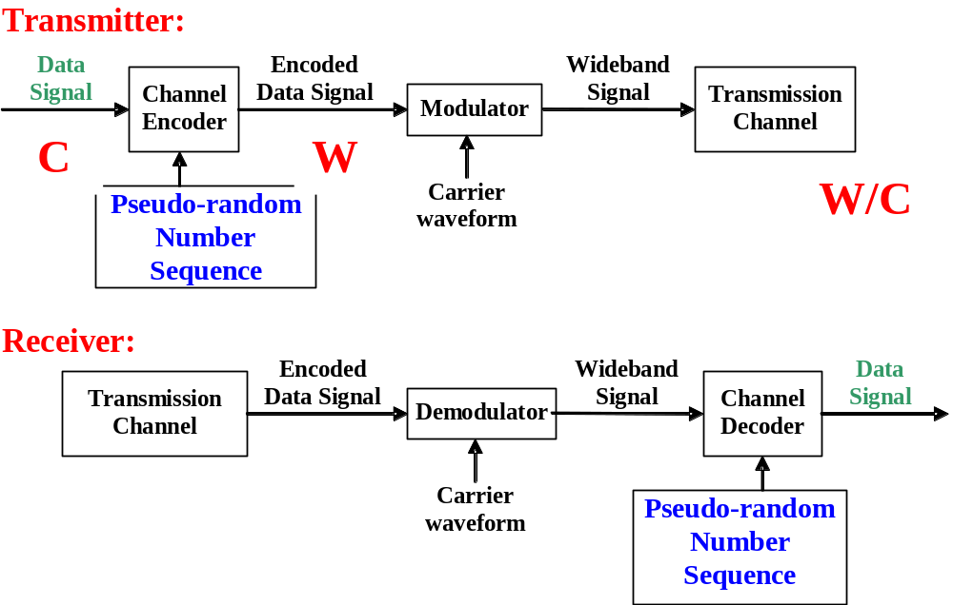
General model of DSSS digital
communications system
BPSK or QPSK
“chipping”.

Slide 14
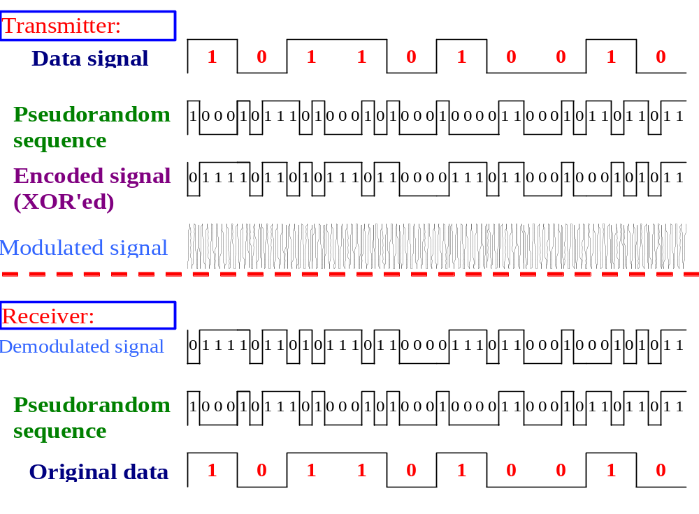
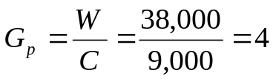
DSSS (Cont)
DSSS

Slide 15
1
0
t
t
t
t
8
b x 8
8
M=8, 16, 32, 64, …

Slide 16
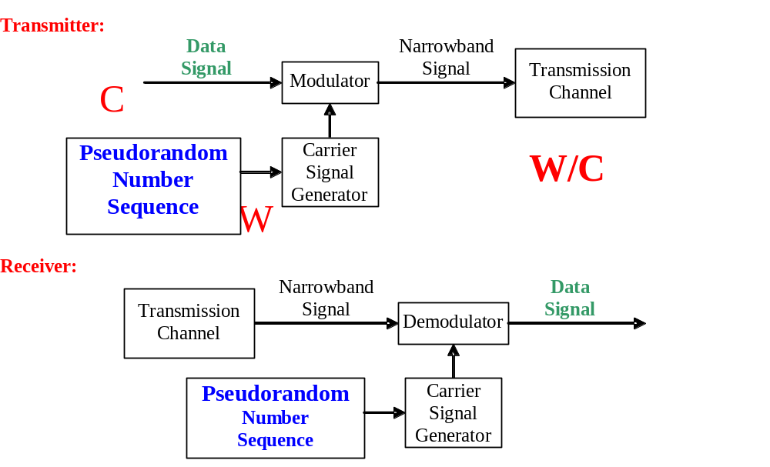
General model of FHSS digital
communications system

Slide 17
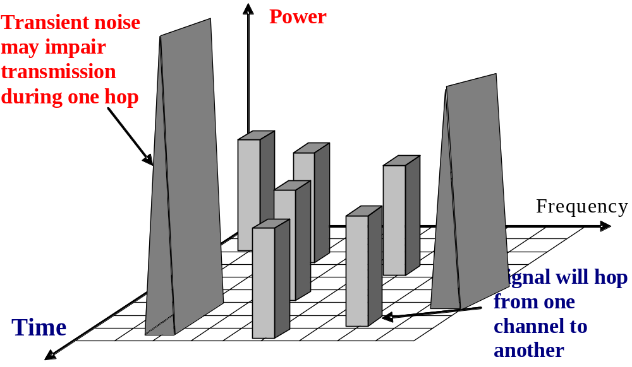
FHSS
1
2
3
FHSS is an ideal for a WLAN in a noisy frequency band !
4
4
During any one hop, the signal is vulnerable to noise in that frequency band, but it will soon move to another frequency with less noise. This new band will be sufficiently removed from the previous noisy band

Slide 18
Example: Bluetooth Frequency Hopping
1Mhz
. . .
1
2
3
79
83.5 Mhz
frequency hopping spread spectrum
  2.402 GHz + k MHz, k=0, …, 79
  1,600 hops per second(1:1600=625 μs)
GFSK modulation
  1 Mb/s symbol rate
transmit power
  0 dBm (up to 20 dBm with power control)

Slide 19
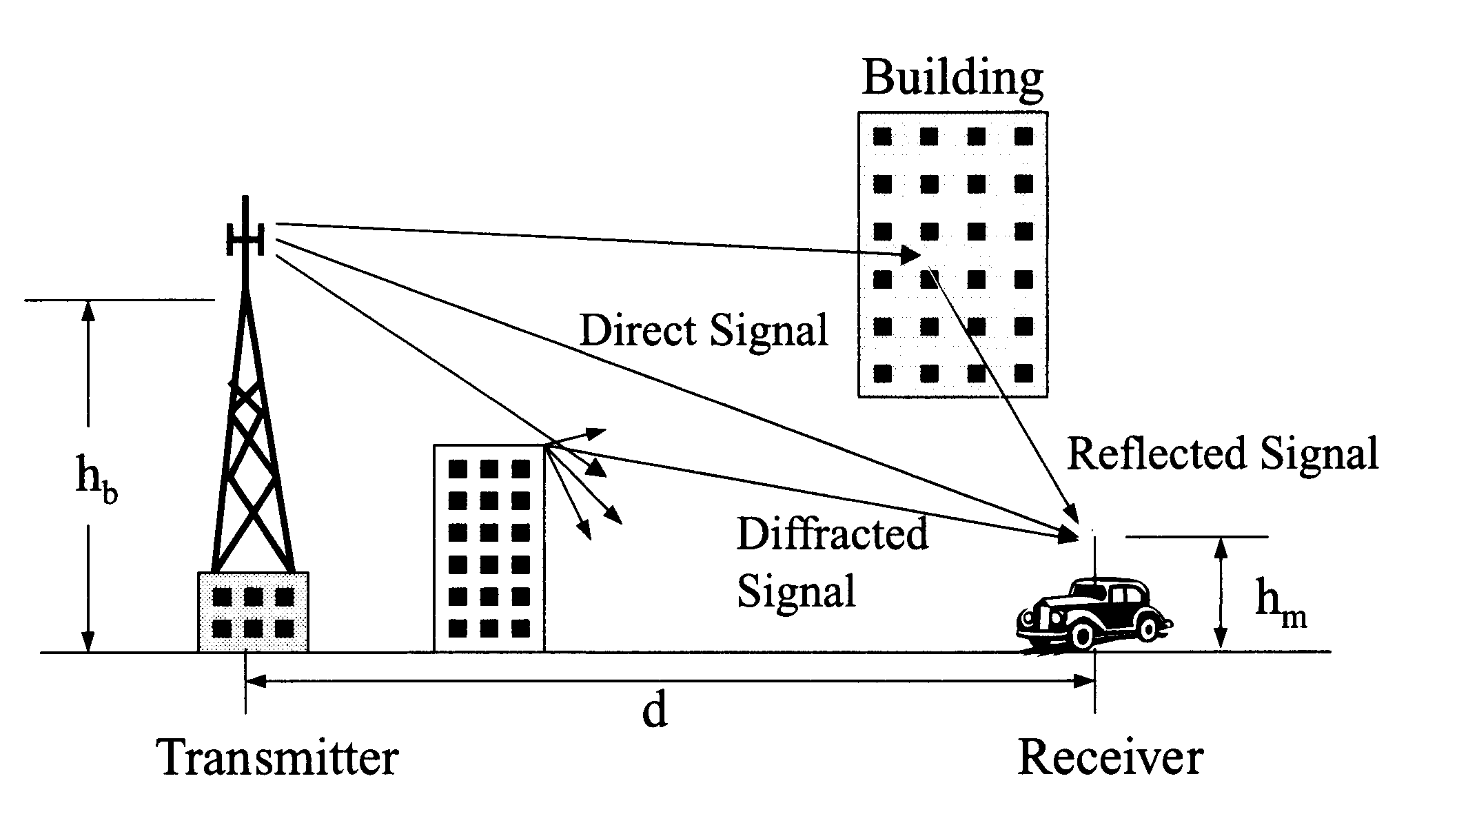
Reflection and diffraction of radio signals (1:1600=625 μs)
Scattering

Slide 20
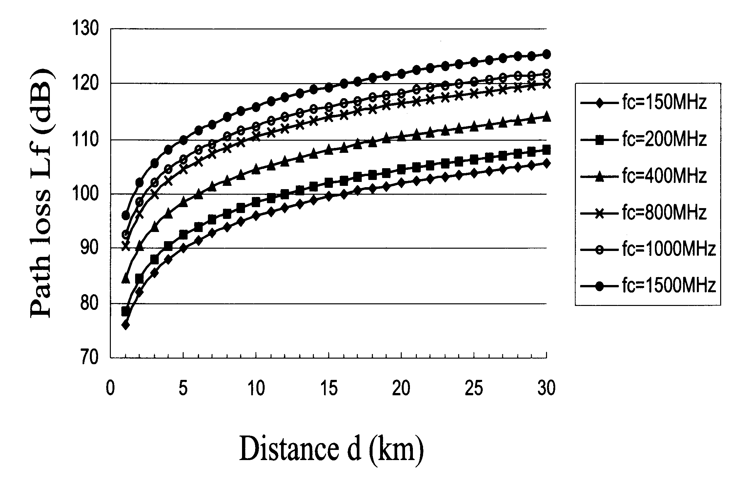
Free-space path loss (Cont)
1500 MHz
150 MHz

Slide 21

802.11 (WiFi) Wireless LAN Configurations
1. Ad-Hoc Networking 2. Peer-to-peer Networking
BS
To send an IP packet over the WLAN, Make 802.11 compatible with Ethernet above the DLL.

Slide 22
Motivation for a specialized MAC
Possible interference at B
A
B
C
D
A
B
C
D
Radio range
a
b
Hidden station problem
Exposed station problem
Two Major Problems

Slide 23
Medium Access with CSMA/CA
When many users are located in the same area, and use the same wireless LAN at the same time, two different MAC methods are defined for signal multiplexing:
1. Distributed Coordination Function (DCF) (no control)
2. Point Coordination Function (PCF) (BS controls cell)
The basic access mechanism, called the DCF, Each unit senses the medium before it starts to transmit. If the medium is free for several microseconds, the unit can transmit for a limited time. If the medium is busy, the unit will back-off for a random time before it senses again.
It does not sense the channel while transmitting,

Slide 24
Medium Access with CSMA/CA (Cont)
The basic access mechanism:
DCF = CSMA/CA algorithm: 2 methods.
1). Physical channel sensing. 2). Virtual channel sensing
Physical channel sensing (PCS): Like Ethernet
It does not sense the channel while transmitting,
CSMA/CD needs full-duplex channel
802.11 all stations cannot hear each other
802.11 =802.3 + Positive Acknowledge Scheme
2. MACAW-Virtual Carrier Sense (VCS)

Slide 25
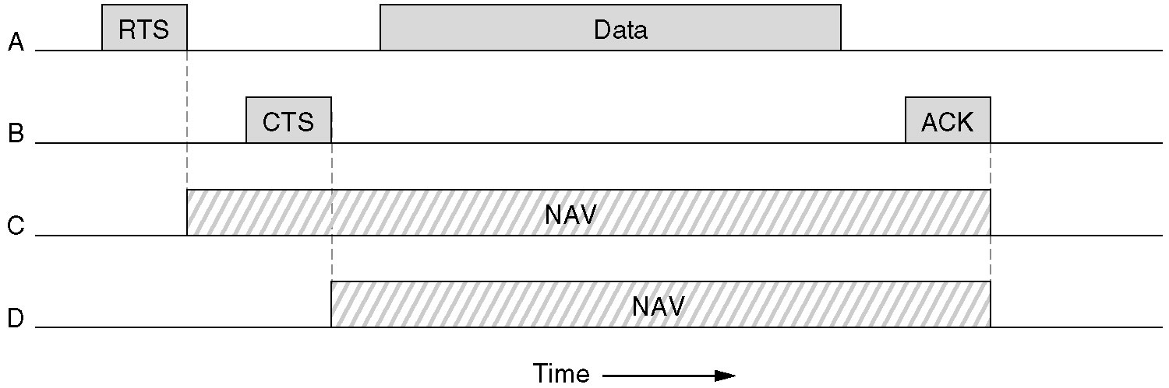
The 802.11 MAC Protocol (MACAW)
2. MACAW-Virtual Carrier Sense (VCS) using CSMA/CA.
NAV-Network Allocation Vector -keeps other stations quiet

Slide 26
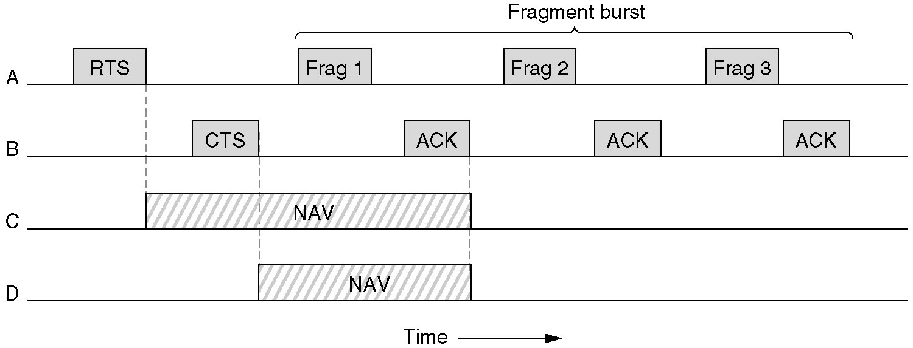
The 802.11 MAC Protocol:
fragments (MACAW)
2. DCF-The use of virtual channel sensing using CSMA/CA.
stop-and-wait protocol

Slide 27
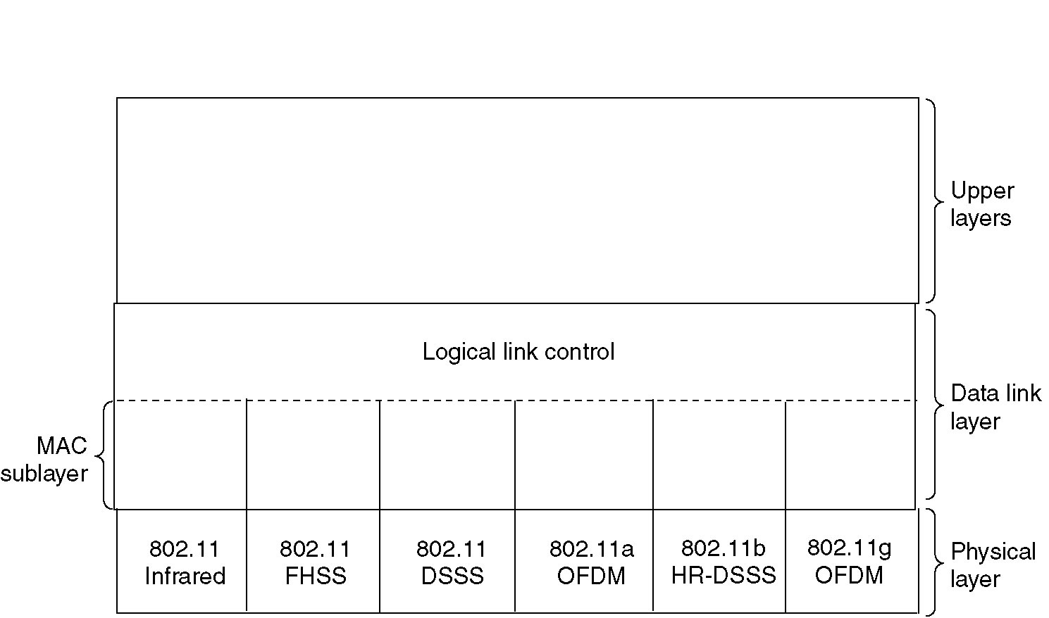
The 802.11 Protocol Stack
LLC sublayer, hides the differences between the different 802 variants and make them undistinguishable for the network .
The MAC sublayer determines how the channel is allocated, who gets to transmit next.
DLL
LLCMAC
Notes:
3 Physical layer Transmission techniques: 1 Infrared, 2 FHSS, 3. DSSS, using Indust. Scint, Medical band

Slide 28
Congestion control (Cont)
Traditional TCP congestion control (TCP Reno) has four key phases:
Slow Start (SS),
Congestion Avoidance (CA),
Fast Retransmit (FT), and
Fast Recovery (FR).
In addition to have a varying Contention Window (CWIN), TCP also employs a value called the “Slow Start Threshold” (SSTresh) to decide between SS and CA phases.
A TCP sender initially begins in the SS phase, which begins with CWIN set to 1. On each successful ACK, we increment by the same CWIN size. Thus, this results in the exponential growth of the CWIN because in each RTT, CWIN = 2 * CWIN. When the CWIN finally exceeds SSTresh, TCP enters the CA phase

Slide 29
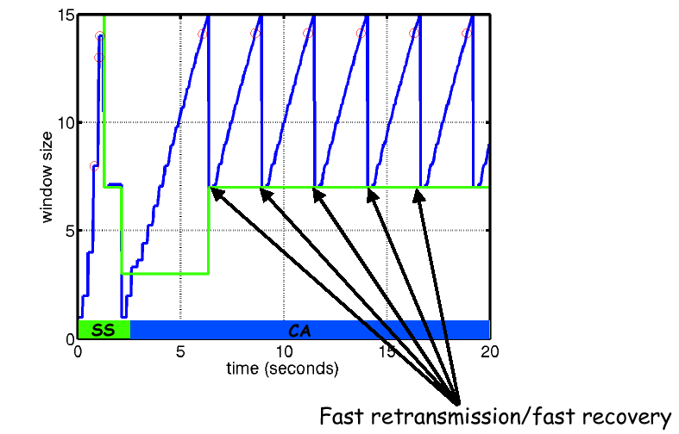
Congestion control (Cont)

Slide 30
TCP Slow Start for reliable comm.
44
40
36
32
28
24
20
16
12
8
4
Congestion window (kilobytes)
congestion-avoidance
Timeout
Threshold
Thr/2
Threshold
Jacobson’s slow start algorithm
Slow start
Threshold
0 2 4 6 8 10 12 14 16 18 20 22 24
Transmission number

Slide 31
Some characteristics of 802.11 WLAN
Characteristic | 802.11A | 802.11B | 802.11B
Topology | Physical star and a logical bus | Physical star and a logical bus | Physical star and a logical bus
MAC | CSMA/CA; Error control Stop-and-wait (S-a-W) | CSMA/CA; S-a-W | CSMA/CA; S-a-W.
Data Transmission in the Physical Layer | D/A – A/D conversion, Combinations of BPSK, QPSK, | D/A – A/D conversion, Combinations of PSK and QPSK modulation | D/A – A/D conversion. For 1 to 11 Mbps uses same modulations as 11 For 6 to 54 Mbps it uses the same modulations as 802.11a.
Rate; Mbps | 6; 9; 12; 18; 24; 36; 48; 54. | 1; 2; and 5.5 | 5.5-11
AP range, m | 15 to 50 | about 100 to 150 | 50–150
Frequency range and BW | 5-GHz. The total BW is 300 MHz, | 2.400 GHz - 2.4835 GHz = 83.5 MHz; | 2.4 GHz. Compatible with 802.11b
Separate radio frequency channels | 4–12 channels; 12 channels with 20 MHz BW is broken into 52 separate 312.5 KHz sub-channels, plus guard bands. 48 of these sub-channels for data; the four are for control. Data is sent across all 48 sub-channels in parallel using a OFDM. | 3 channels centered on: 2.412; 2.437; 2.462 GHz. with a 3-MHz guard- band | 3–6 channels depending upon configuration

Slide 32
Unlicensed Radio Spectrum
λ
33cm
12cm
5cm
26 Mhz
83.5 Mhz
125 Mhz
902 Mhz
2.4 Ghz
5.725 Ghz
928 Mhz
2.4835 Ghz
5.785 Ghz
cordless phones,
baby monitors,
Wireless LANs
802.11 Cell.
802.15 Bluetooth,
Microwave oven
802.11a
HyperLan

Slide 33
Bluetooth radio link
1MHz
. . .
1
2
3
79
83.5 MHz
frequency hopping spread spectrum
  2.402 GHz + k x1MHz, k=0, …, 78=79
  1,600 hops per second (1:1600=625 μs)
FHSS/TDD channel applied in Bluetooth.
Multiple Ad hoc links will make use of different hopping channels with different hopping sequences and have misaligned slot timing

Slide 34
Voice and Data Links
Bluetooth allows both time sensitive communication: voice or audio, and time insensitive packet: data communication.
So, two different types of links are defined:
Synchronous Connection Oriented (SCO) links
for voice communication
Asynchronous Connectionless (ACL) links
for data communication.
ACL data packets are: a 72-bit access code, a 54-bit packet header and a 16-bit CRC code, in addition to the payload data.
Different types of packets allow different amounts of data to be sent: The largest packet data payload is a DH5 (Data High) packet, with 5 slots. A DH5 packet carry 339 bytes, or 2712 bits of data. So, 2858 bits are sent for 2712 bits of information, and the minimum length reply is one slot.
Thus, the maximum baseband data rate in one direction is 723.2 kb/s.
With 5-slot packet sent in one direction, the 1-slot packet sent in the other direction, so this would be an asymmetric link.

Slide 35
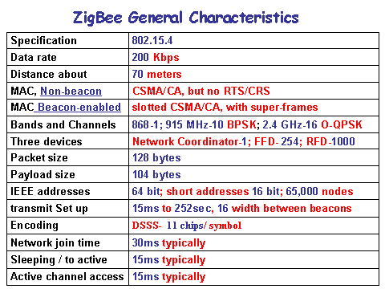

Slide 36
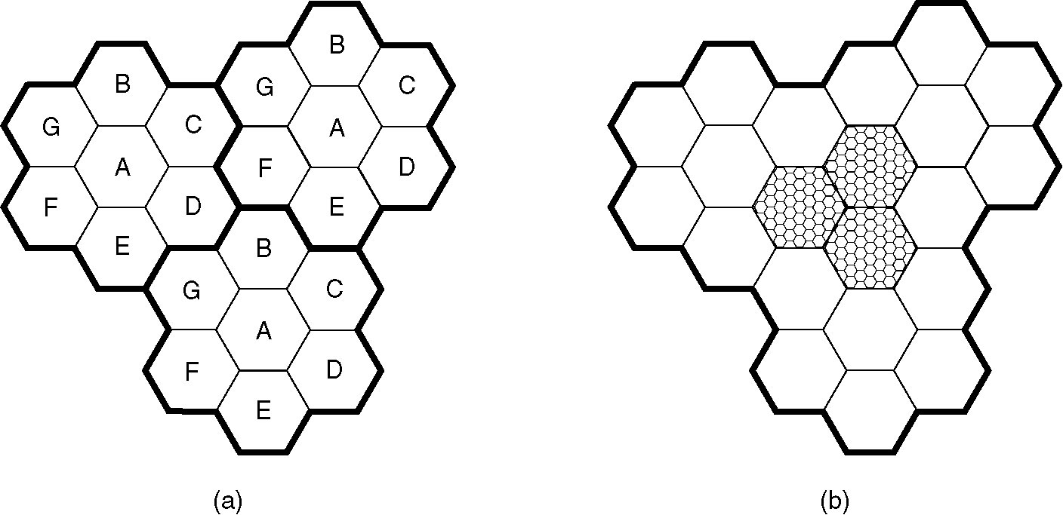
Advanced Mobile Phone System (AMPS)
(1982)
100 cells
10-20 km
Frequencies are not reused in in a group of 7 adjacent cells
To add more users, smaller cells can be used.
In each cell, 57 channels (duplex: uplink and downlink)
about 800 channels total (across the entire AMPS system
AMPS is an analog system using FDMA.

Slide 37
BS
Control
(PROM; 21)
Paging
(#)
Data
Access
(“U” ; “D”)
MS

Slide 38
Cellular Concepts
Geographical separation
Capacity (frequency) reuse
Backbone connectivity
Hand-held telephone 0.6 watts; Car transmitters are 3 watts, Maximum. by the FCC.
Backbone connectivity
The base station consists of a computers and transmitter/receiver connected to an antenna.
BS
BS
BS
MTSO (Mobile Telephone Switching office)- MSC (Mobile Switching Center).
Publ. Swit. Tel. Net.
BS
BS
BS

Slide 39

Handoff (Cellular Concepts)
Soft Handoff: simultaneous radio link between MS and different BSs
Hard handoff: The old BS drops the MS before the new one acquires it.

Slide 40
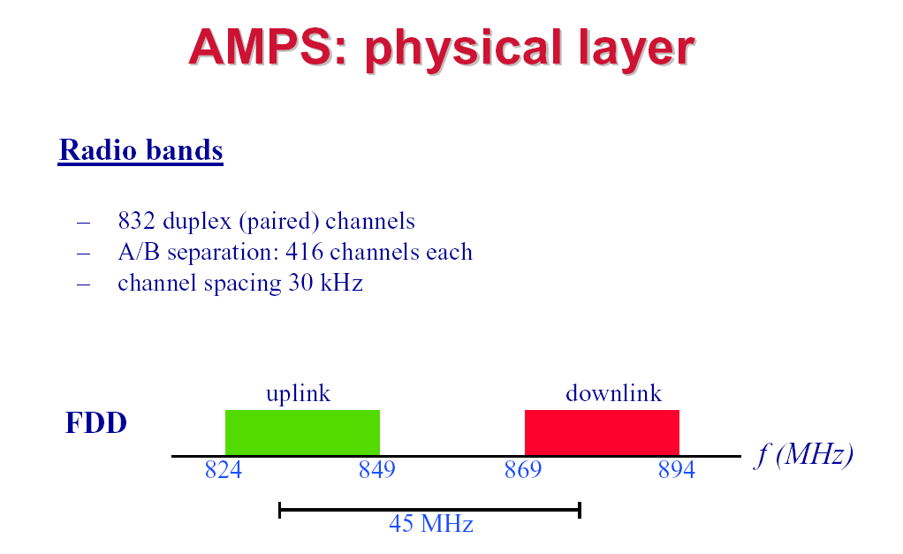
AMPS uses FDD to separate the channels.
Each simplex channels is 30 KHz wide. 832 x 30 =24960 KHz
(A) 832 channels (B) 832 channels
(Freq Division
Duplex)
25 MHz

Slide 41
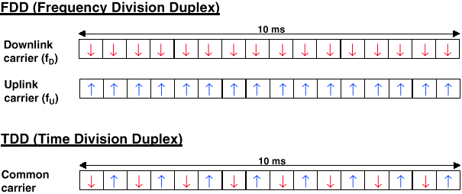
FDD & TDD duplexing

Slide 42
wide-area "mobile" service
5G cell
4G cell
A=B=C=D=E=F=G
Small cells densely
"short" wireless links + fiber optic cable
B
Urban area
C
G
A
D
F/O link
m3
Device densities of up to 100 devices/m2
F
E
m1
m2
MSO
Wave bands (20 – 60 GHz)
data-access speeds of up to 10 Gbit/s

Slide 43
The following course outcome for
CS M117
Understand the properties of communication channe
b. Understand signal modulation, multiplexing and multiple access processes.
c. Understand MAC Protocols for reliable and noisy channels.
d. Understand Wireless LAN and PAN design and operations.
e. Understand structures of Computer Communication systems.
f. Final comprehensive project requiring the student to re-design and re-think one of the experiments he/she performed.

Slide 44
THANK YOU!

Slide 45
Grading
A numerical scores conversion to the letter grades
A+ | A | A- | B+ | B | B-
[100-96] | (96-93] | (93-90] | (90-86] | (86-83] | (83-80]
+0.5

